Slide 1
Homeostasis
Maintaining the balance

Slide 2
BILL: What conditions do we need to regulate in order to maintain homeostasis?
Come up with at least 3 things.

Slide 3
Maintaining the balance…
Homeostasis hugs! Bozeman science

Slide 4
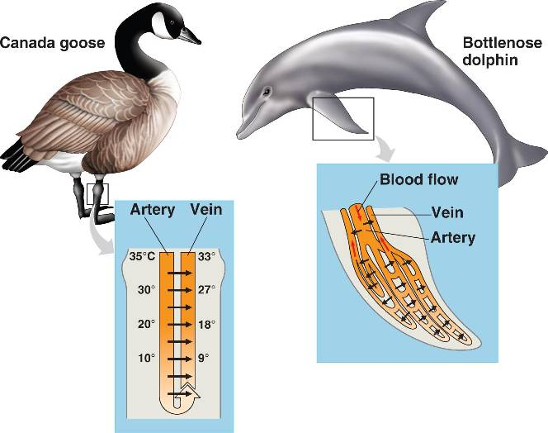
Countercurrent exchange
Flow in opposite directions
Materials (heat, water, salt, gases, etc) flow from high → low
Concentration gradients maintained

Slide 5
Other important concepts in homeostasis
Negative feedback loops
Positive feedback
Conformers vs. regulators

Slide 6
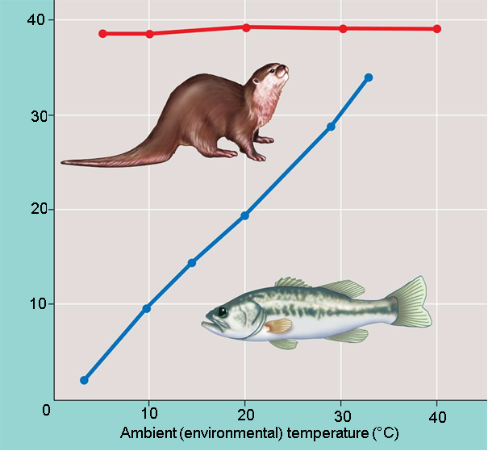

Slide 7
Conformers vs. regulators

Slide 8
What are some of the benefits and drawbacks of each strategy?
Conformers | Regulators
Benefits: very low energy needs, do not need to eat a lot | Benefits: constant metabolism, can inhabit many different environments
Drawbacks: metabolism and enzyme function are dependent on environment, cold temp = low metabolism | Drawbacks: need a lot of food to meet energy needs

Slide 9
Energy budget for 4 animals

Slide 10
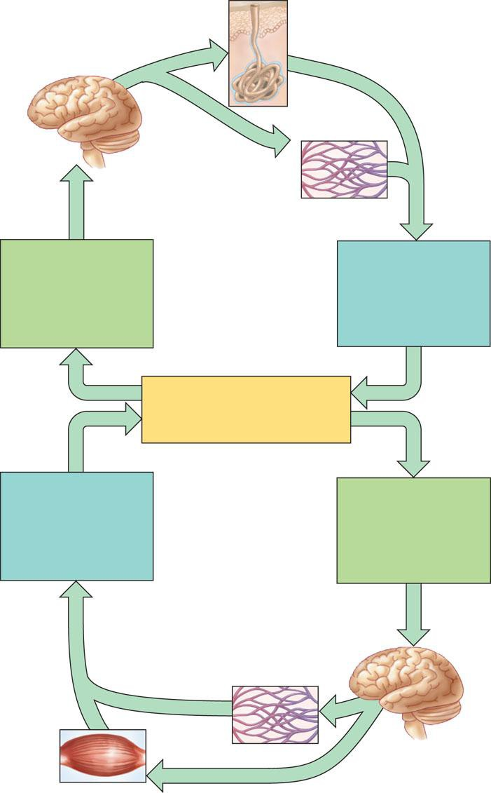
Thermoregulation in Humans

Slide 11
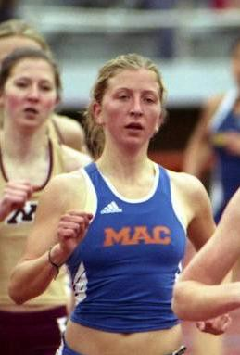
Increased body temperature: resulting from exercising or being in a hot environment

Slide 12
Increased body temperature
Homeostasis
Internal body temperature 36-38 C

Slide 13
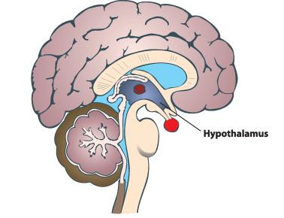

Slide 14
Thermostat in hypothalamus activates cooling mechanisms
Increased body temperature
Homeostasis
Internal body temperature 36-38 C

Slide 16
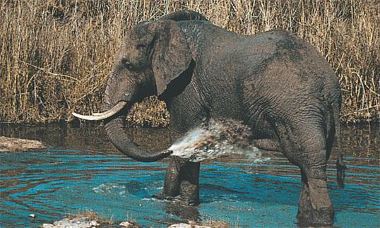
A terrestrial mammal bathing, an adaptation that enhances evaporative cooling

Slide 17
Sweat glands secrete sweat that evaporates cooling the body
Thermostat in hypothalamus activates cooling mechanisms
Increased body temperature
Homeostasis
Internal body temperature 36-38 C

Slide 18
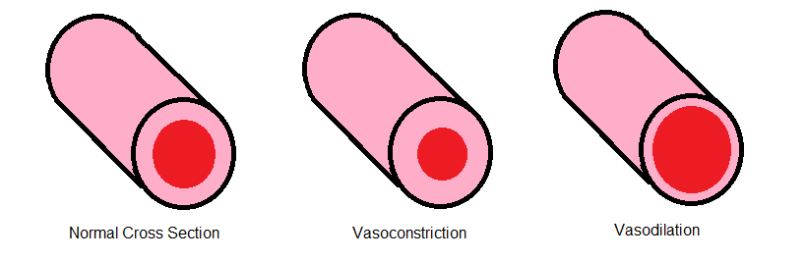
vasodialation

Slide 19
Sweat glands secrete sweat that evaporates cooling the body
Thermostat in hypothalamus activates cooling mechanisms
Blood vessels in skin open: capillaries fill with warm blood; heat radiates from skin surface out of the body. vasodilation
Increased body temperature
Homeostasis
Internal body temperature 36-38 C

Slide 20
Sweat glands secrete sweat that evaporates cooling the body
Thermostat in hypothalamus activates cooling mechanisms
Blood vessels in skin open: capillaries fill with warm blood; heat radiates from skin surface out of the body. vasodilation
Increased body temperature
Body temperature decreases
Homeostasis
Internal body temperature 36-38 C

Slide 21
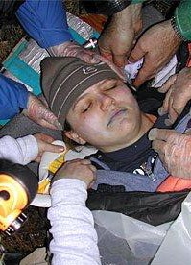
Decreased Body temperature: such as when in a cold environment

Slide 22
Sweat glands secrete sweat that evaporates cooling the body
Thermostat in hypothalamus activates cooling mechanisms
Blood vessels in skin open: capillaries fill with warm blood; heat radiates from skin surface out of the body. vasodilation
Increased body temperature
Body temperature decreases
Homeostasis
Internal body temperature 36-38 C
Decreased body temperature

Slide 24
Sweat glands secrete sweat that evaporates cooling the body
Thermostat in hypothalamus activates cooling mechanisms
Blood vessels in skin open: capillaries fill with warm blood; heat radiates from skin surface out of the body. vasodilation
Increased body temperature
Body temperature decreases
Homeostasis
Internal body temperature 36-38 C
Decreased body temperature
Thermostat in hypothalamus activates warming mechanisms

Slide 25
vasoconstriction

Slide 26
Sweat glands secrete sweat that evaporates cooling the body
Thermostat in hypothalamus activates cooling mechanisms
Blood vessels in skin open: capillaries fill with warm blood; heat radiates from skin surface out of the body. vasodilation
Increased body temperature
Body temperature decreases
Homeostasis
Internal body temperature 36-38 C
Decreased body temperature
Blood vessels constrict, diverting blood from skin to deeper tissues and reducing heat loss from skin surface. vasoconstriction
Thermostat in hypothalamus activates warming mechanisms

Slide 27

shivering

Slide 28
Sweat glands secrete sweat that evaporates cooling the body
Thermostat in hypothalamus activates cooling mechanisms
Blood vessels in skin open: capillaries fill with warm blood; heat radiates from skin surface out of the body. vasodilation
Increased body temperature
Body temperature decreases
Homeostasis
Internal body temperature 36-38 C
Decreased body temperature
Blood vessels constrict, diverting blood from skin to deeper tissues and reducing heat loss from skin surface. vasoconstriction
Skeletal muscles rapidly
contract, expending energy though cell respiration which generates heat as a by product. shivering
Thermostat in hypothalamus activates warming mechanisms

Slide 29
Sweat glands secrete sweat that evaporates cooling the body
Thermostat in hypothalamus activates cooling mechanisms
Blood vessels in skin open: capillaries fill with warm blood; heat radiates from skin surface out of the body. vasodilation
Increased body temperature
Body temperature decreases
Homeostasis
Internal body temperature 36-38 C
Body temperature increases
Decreased body temperature
Blood vessels constrict, diverting blood from skin to deeper tissues and reducing heat loss from skin surface. vasoconstriction
Skeletal muscles rapidly
contract, expending energy though cell respiration which generates heat as a by product. shivering
Thermostat in hypothalamus activates warming mechanisms

Slide 30
BILL: Draw the negative feedback loop for temperature regulation without looking at your notes.

Slide 31
Sweat glands secrete sweat that evaporates cooling the body
Thermostat in hypothalamus activates cooling mechanisms
Blood vessels in skin open: capillaries fill with warm blood; heat radiates from skin surface out of the body. vasodilation
Increased body temperature
Body temperature decreases
Homeostasis
Internal body temperature 36-38 C
Body temperature increases
Decreased body temperature
Blood vessels constrict, diverting blood from skin to deeper tissues and reducing heat loss from skin surface. vasoconstriction
Skeletal muscles rapidly
contract, expending energy though cell respiration which generates heat as a by product. shivering
Thermostat in hypothalamus activates warming mechanisms

Slide 32
What about blood sugar…
Beta cells in pancreas release insulin which signals cells to take in glucose and the liver to take up glucose and store it as glycogen
Alpha cells in the pancreas release glucagon which signals the liver to break down glucagon into glucose
Create a negative feedback diagram for the information above.

Slide 33
